Slide 1
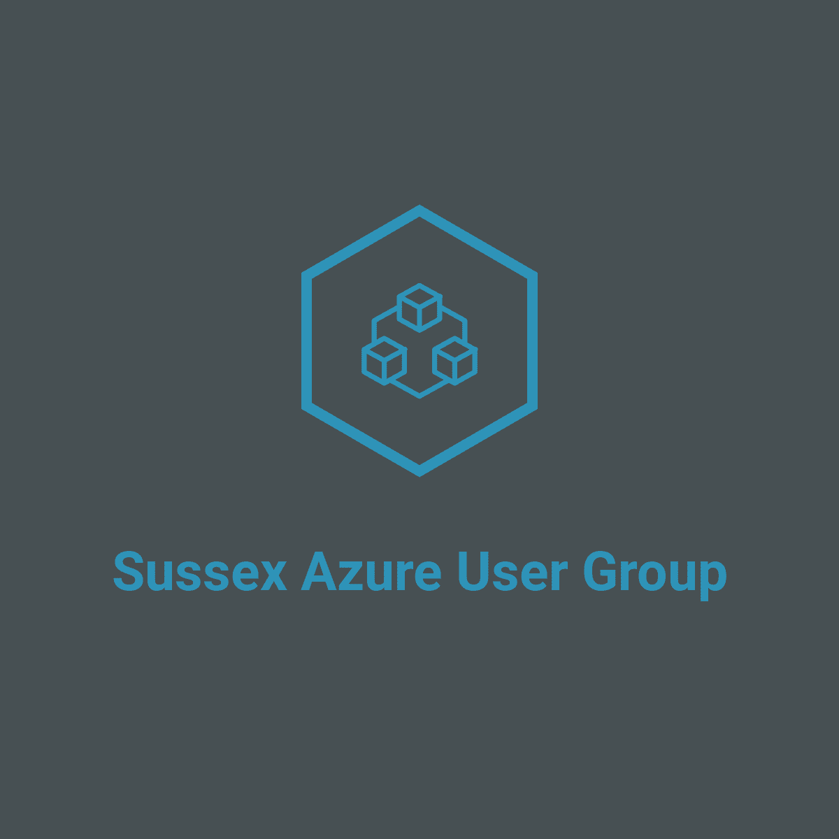
May 2019 Meetup
@ The Skiff - Brighton

Slide 2
Hybrid Connectivity Options To Azure
Hosted By
Jack Tracey – Solutions Architect

Slide 3


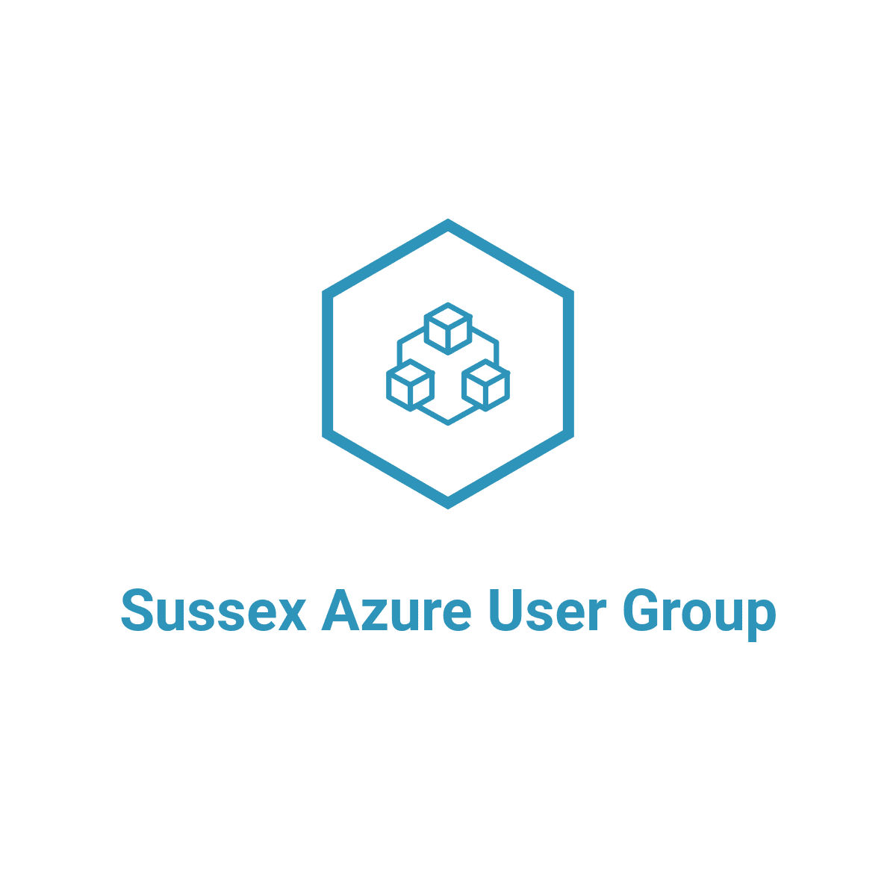



ABOUT ME
Jack Tracey
Solutions Architect - Public Cloud Architecture for CDW UK
Co-Founder of Sussex Azure User Group
jacktracey.co.uk
sussexazure.uk
@jack_ref
@SussexAzure
jtracey93
SussexAzure

Slide 4
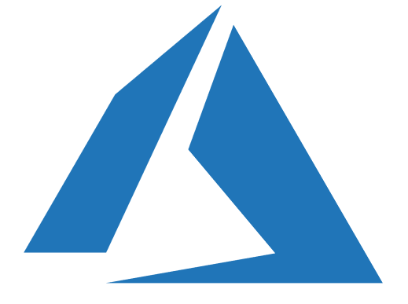
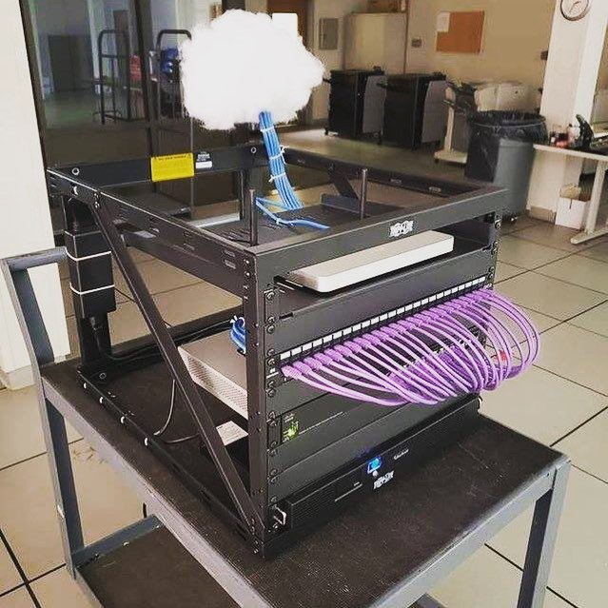


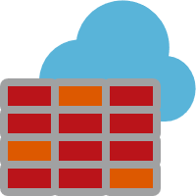

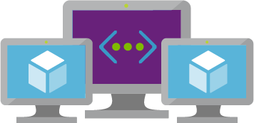
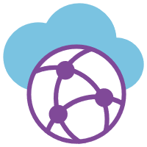
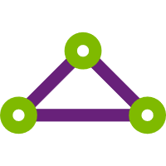
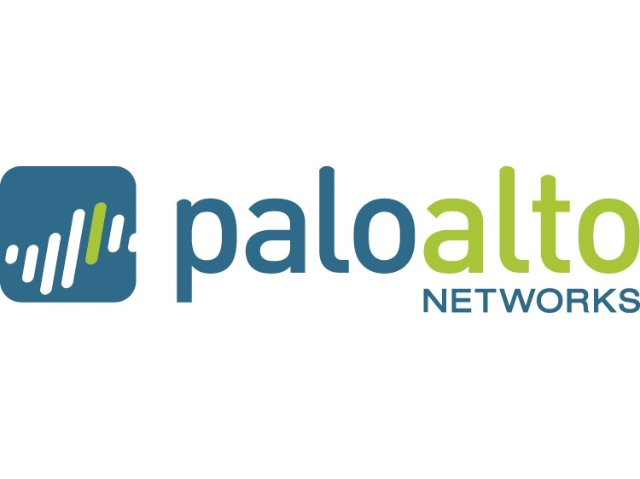

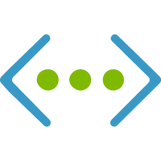
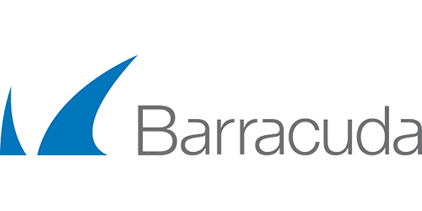
CONNECTING TO THE CLOUD
Lots of options:
Site-To-Site VPN
Point-To-Site VPN
ExpressRoute
Virtual WAN
NVAs (Network Virtual Appliances)

Slide 5

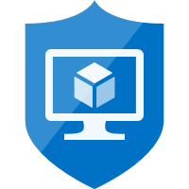

NETWORKING – WITHIN AZURE
VNET (Virtual Network)
- Entire network in a bubble
- By default everything within a VNET can talk can talk to everything on all ports (any/any)
- Internet access provided without the need for any other service
- Only data leaving a VNET is charged for
NSG (Network Security Group) & ASG (Application Security Group)
- NSG - Stateful – Only have to allow traffic one way & return traffic (same sessions) is permitted
- NSG – Allow you to permit/block traffic on a NIC or Subnet (can also be applied to both)
- NSG – Use Service Tags – https://aka.ms/servicetags
- NSG – No NSG applied at all, by default allows everything from anywhere!
- ASG – Allow you to group servers of similar function together to make NSG creation easier
UDR (Route Table)
- Applied to subnets to overwrite the Azure VNET routing table
- Used when NVA (Network Virtual Appliances) like Palo Alto, Fortigate devices are deployed

Slide 6
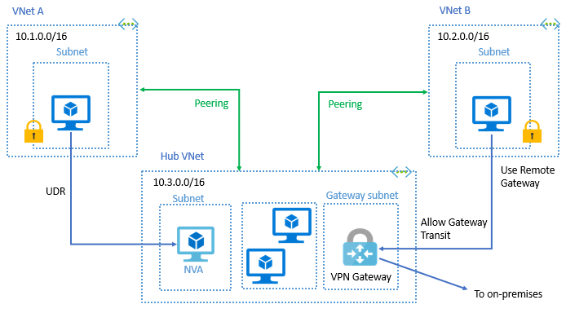
NETWORKING – CONTINUED…
VNET PEERING
- Global VNET Peering Allows you to peer with VNETs in other Azure Regions
- Nominal data charges apply for data transferred across peering's
- Can peer across subscriptions
NVA (Network Virtual Appliances)
- Build IaaS VMs that run virtual networking appliances – Palo Alto, Cisco, FortiGate etc…
- HA is complicated – Palo Alto & FortiGate have best HA features
- Use UDR’s to force traffic to NVAs from subnets
- Azure Firewall may take this pain away – more later on this…
Service Endpoints
- Allows PaaS services to connect to VNET instead of only being accessible via Internet
- Not all services support Service Endpoints, support being added for products daily
- Allows a tighter security boundary to be created

Slide 7
DEMO:
VNETs, Peering's, NSGs, ASGs, Service Tags & UDRs

Slide 8
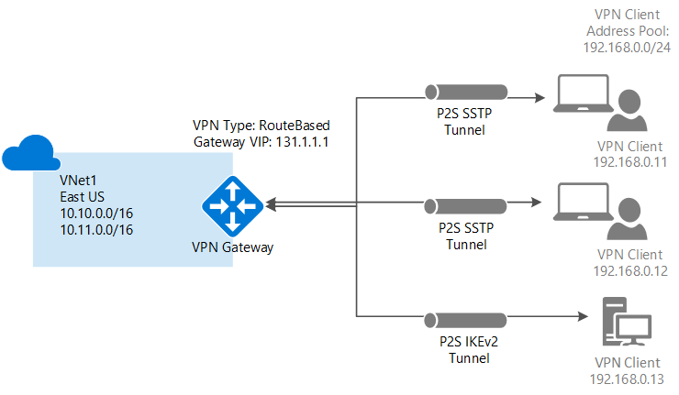
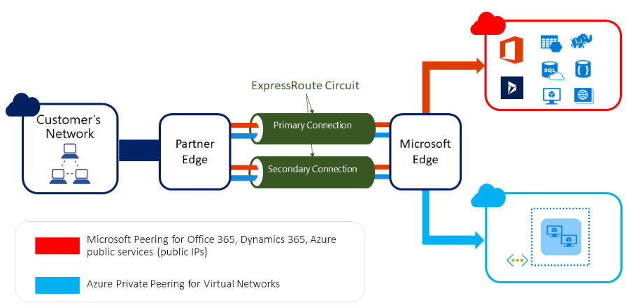
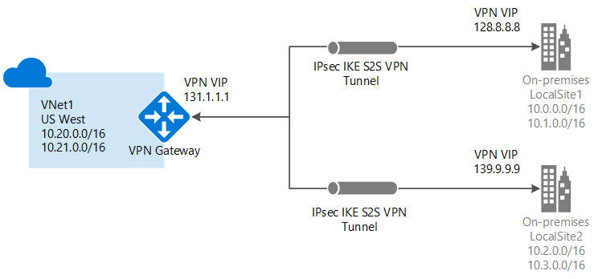
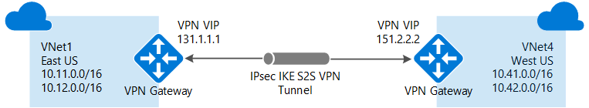
NETWORKING – TO/FROM AZURE
VPN – Site-To-Site
- Used to connect Azure VNET to a On-Premise site (via firewall etc..)
- Uses VPN Gateway, Local Network Gateway & a Connection
- Deployed to ‘GatewaySubnet’ within a VNET
- Can be used to connect 2 VNETs together a.k.a. VNET To VNET Gateway/VPN
VPN – Point-To-Site
- Used to connect user devices (laptop etc…) to Azure VNET
- Uses VPN Gateway as well (same one)
- Not very common, product has been updated recently to utilise OpenVPN client
ExpressRoute
- Private dedicated physical connection into Azure
- 2 Peering types - Azure Private & Microsoft Peering
- Layer 3 connectivity only. No Layer 2
- Requires use of BGP for resilience
- Uses ExpressRoute Gateway in ‘GatewaySubnet’ within a VNET

Slide 9
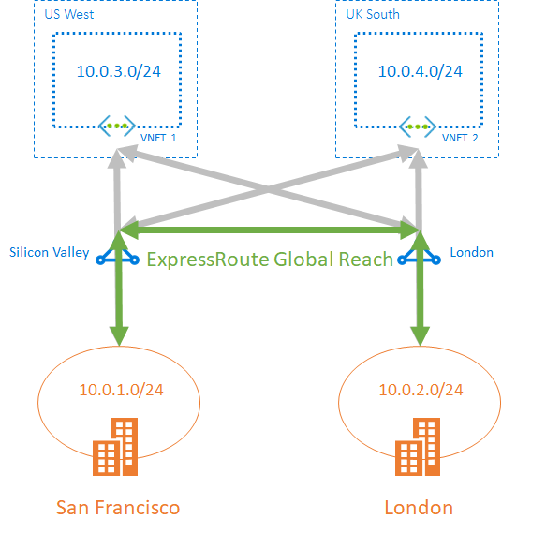
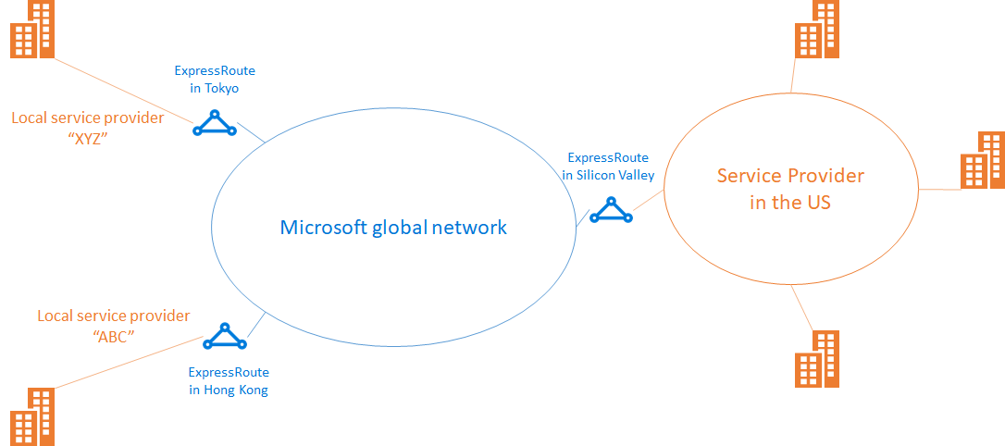
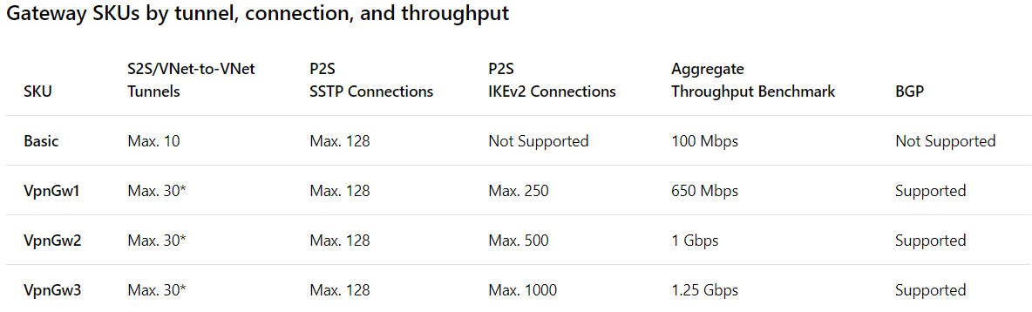
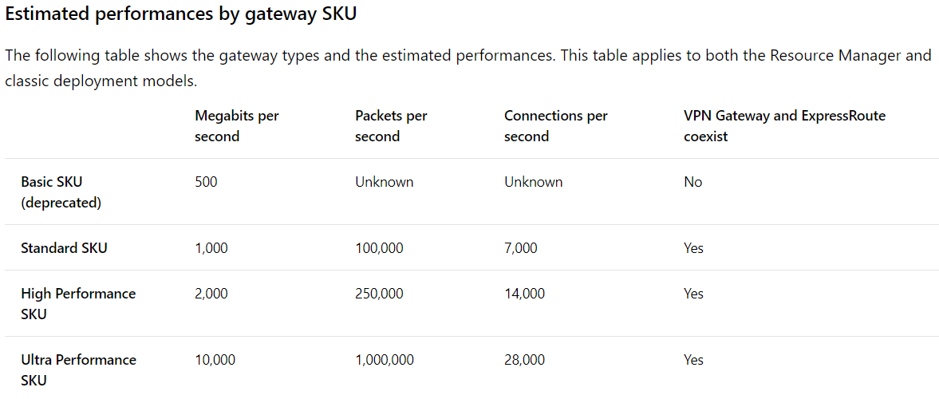
VPN & EXPESSROUTE SKU’S/TIERS
VPN Gateway
- 99.95% SLA on the 3 new tiers VpnGw1/2/3
- Different throughput and connection limits per SKU:
- Remember as VPNs cross the public internet there is no guarantee of throughput as no QoS etc…
ExpressRoute
- 99.95% SLA but is only from your VNET to where Microsoft handoff to provider like Verizon etc…
- Multiple different speeds available depending on connectivity provider used and peering location
- 3 SKU’s for the Gateway:
- Standard & Premium tiers – Premium enables more routes to be received & amount of VNETs that can use the ExpressRoute Circuit. Can also connect to VNETs outside of the geopolitical boundary.
- ExpressRoute Direct - allows you to cut out the connectivity provider and connect directly to Azure edge routers – very rare use cases but for clients who require dual 100 Gbps connectivity to Azure
- ExpressRoute Global Reach – Allows you to link ExpressRoute Circuits together to connect your private networks across the Microsoft network backbone. *Went GA 17th April 2019*

Slide 10
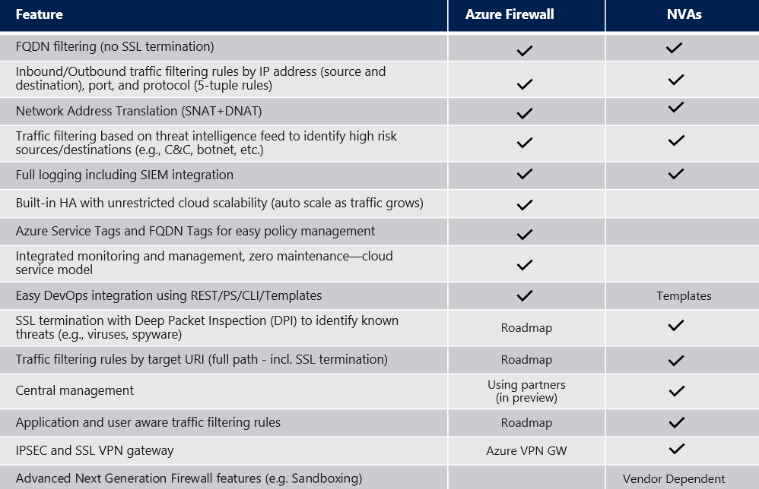
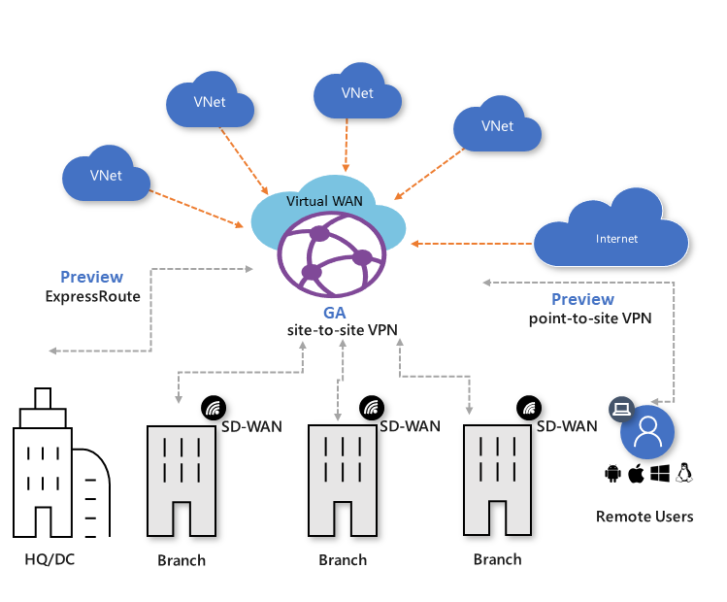
VIRTUAL WAN & AZURE FIREWALL
Virtual WAN
- Azure’s answer to the SD-WAN market
- Branch to Branch & Branch to Azure VNET connectivity via the Microsoft backbone
- Site-to-Site VPN is only currently in GA
- ExpressRoute & Point-to-Site connections are currently in preview
- Not supported in every region currently but being rolled out across more regions weekly
Azure Firewall
- Azure’s answer to an NVA/Firewall
- Built in high availability
- Unrestricted scalability
- Outbound SNAT & Inbound DNAT support
- Layer 3 & 4 security rule filtering
- Product lacks maturity; quite a few major limitations for more enterprise deployments
- Lots of new features announced on roadmap this week via the Azure Blog – also 46% price drop

Slide 11
WATCH OUT FOR…
How is your DR/HA networking configured?
- See it forgotten way to many times
- VM & Applications are perfectly protected but no one can get to them if it failed over
Do you need the ability to perform DR “Bubble” tests?
- Be careful as Azure assumes anyone with writes to deploy resources knows what they are doing!
- Take advantage of Azure’s SDN – configure another VNET with same Address Space and just don’t connect it to other VNETs! – Use Public IPs directly on instances or a Load Balancer to get in to your bubble VNET
Asymmetric Routing
- Probably my favourite issue to troubleshoot & fix
- Remember PINGs use ICMP and they can survive asymmetric routing – Use Test-NetConnection - DEMO
- If using NVAs always check session tables and flows – check bytes/packet count inbound & outbound
IP Address Management
- This is vital in a world were networks can be configured at the click of a button
- I've used NetBox from Digital Ocean - https://github.com/digitalocean/netbox
- Even having a spreadsheet will be sufficient in most environments – just know what IP is where!

Slide 12
THANK YOU
sussexazure.uk
jacktracey.co.uk
@SussexAzure
@jack_ref
SussexAzure
jtracey93

